Slide 1



Job Application MARKET
Sajan, Neelima, SANDHYA,PAVAN

Slide 2

Goals of the PROJECT
Is there a significant difference between the proportion of males vs nonmales who are employed given their degree in higher education?
Is there a difference in the average number of computer skills acquired based on level of education?
Is age a significant factor in determining whether an individual is a professional developer or not?
Is status mental health associated with a programmer’s previous salary?

Slide 3

Exploratory Data Analysis
Plots depicting the data characteristics
Mention how we defined the data and how we cleaned it
We'll also want the descriptions of the data variables here

Slide 4
Statistical Data
Name | Value
Rows | 73,462
Columns | 15
Discrete columns | 8
Continuous columns | 7
All missing columns | 0
Missing observations | 0
Complete Rows | 73,462
Total observations | 1,101,930
Memory allocation | 18.4 Mb

Slide 5
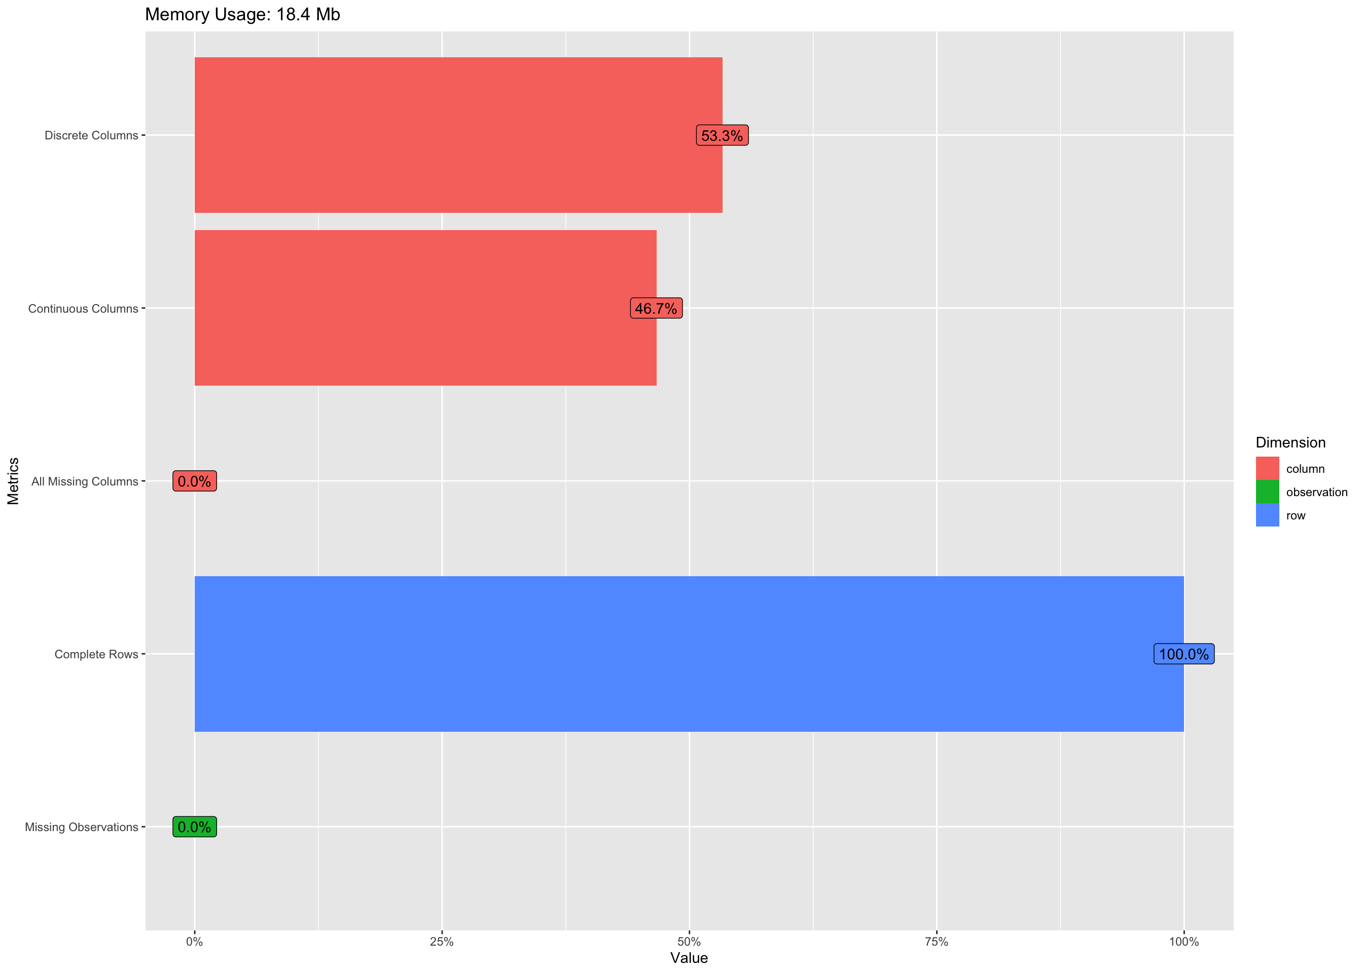
PERCENTAGES

Slide 6
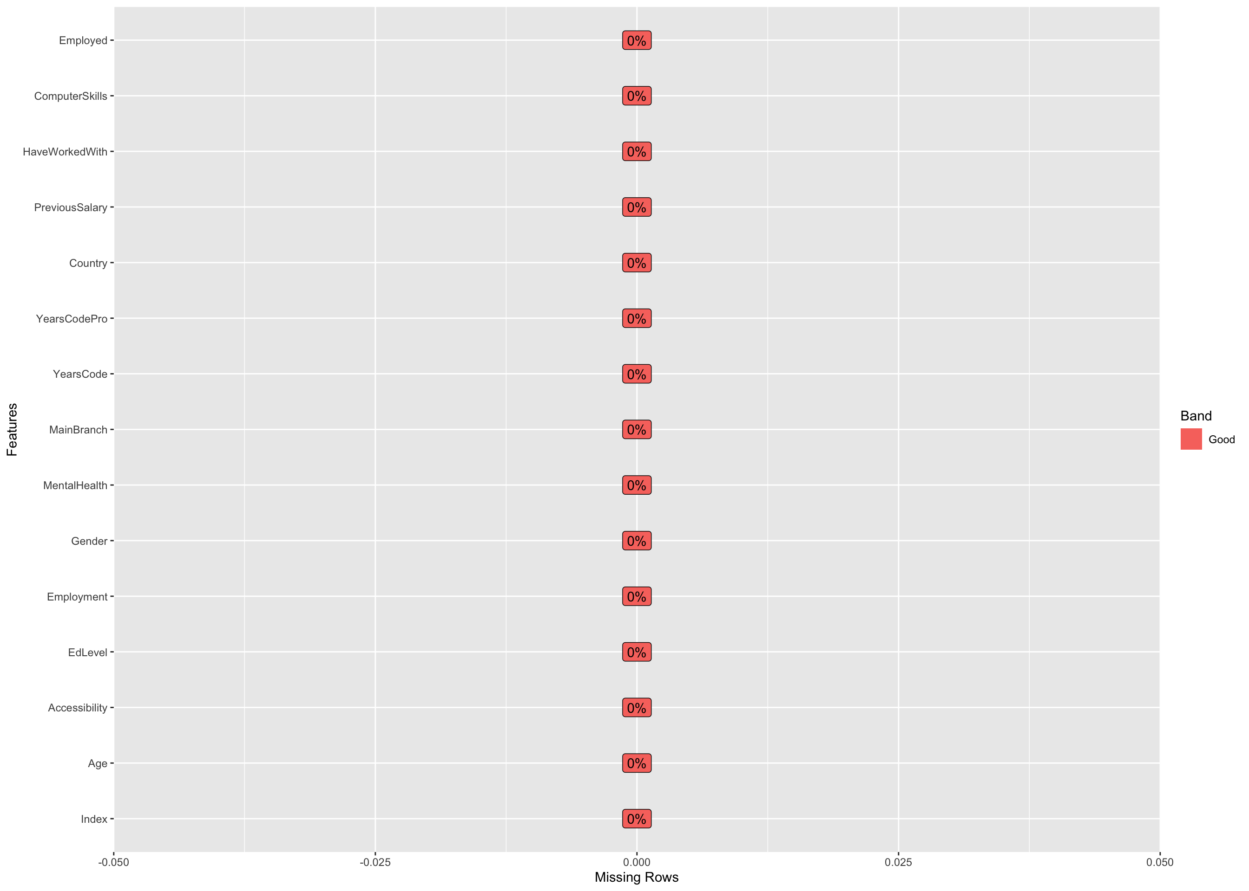
Missing Data Profile

Slide 7
Univariate Distribution
Univariate distribution is a statistical concept describing the probability distribution of a single variable or dataset.
It provides insights into the frequency and variation of values within that variable, helping analyze central tendencies (mean, median), spread (variance, standard deviation), and the shape of the data distribution.

Slide 8
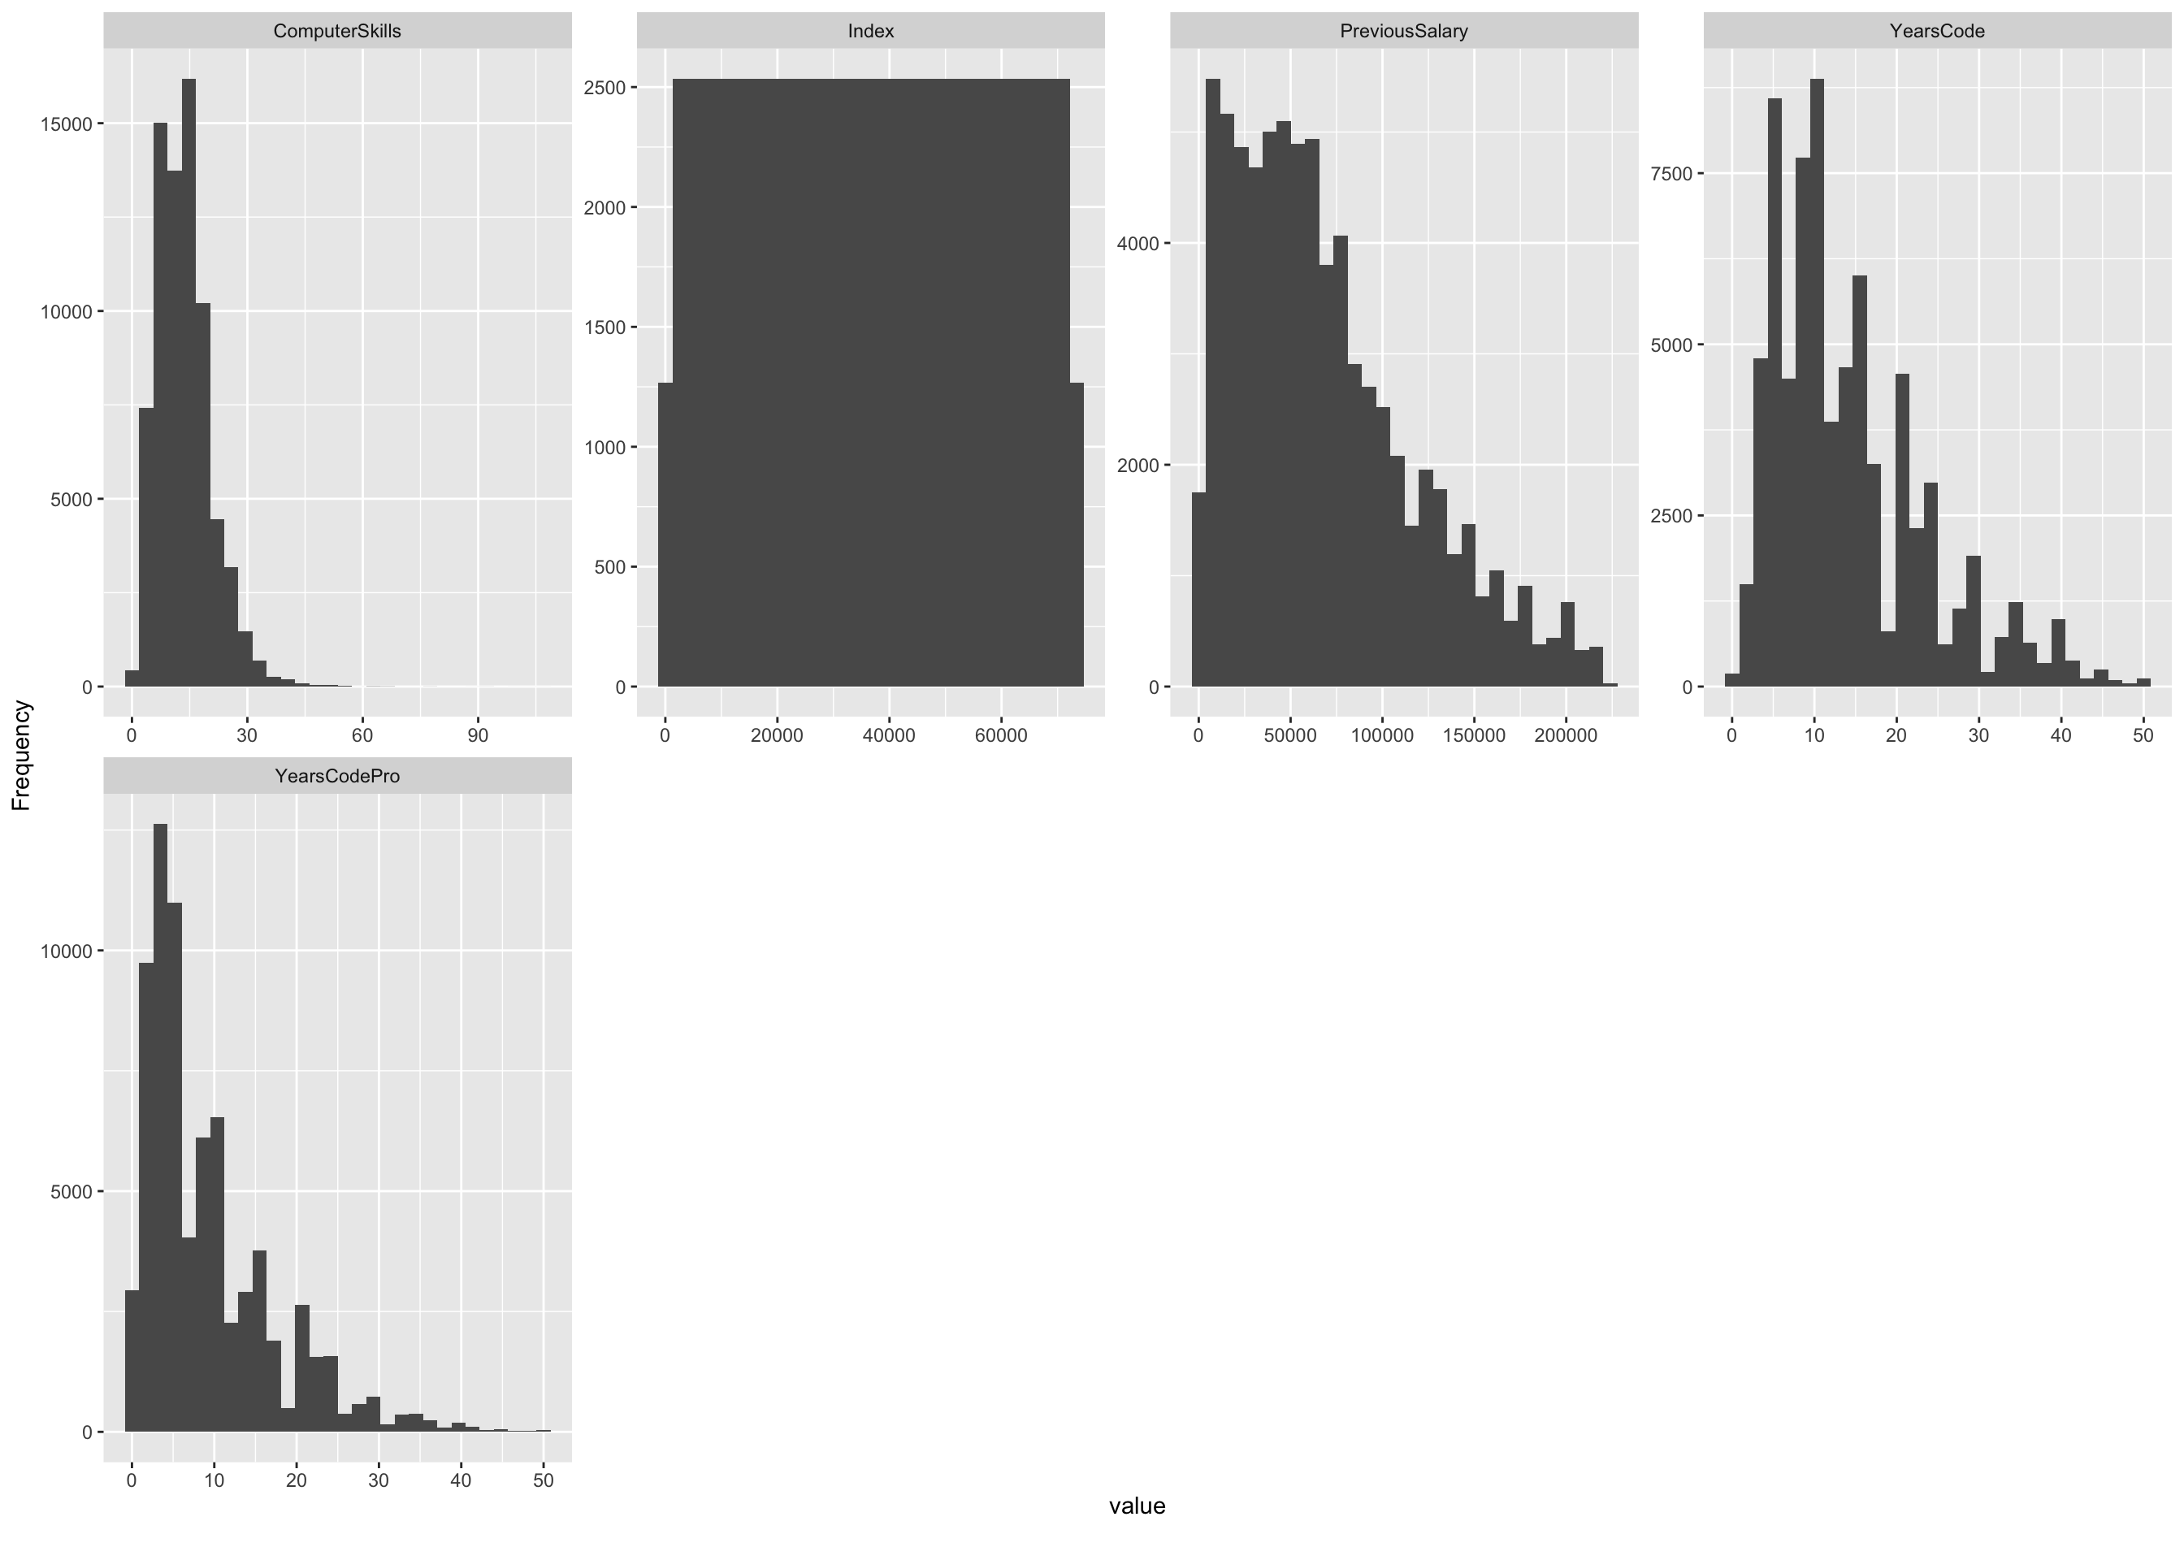
Histogram

Slide 9
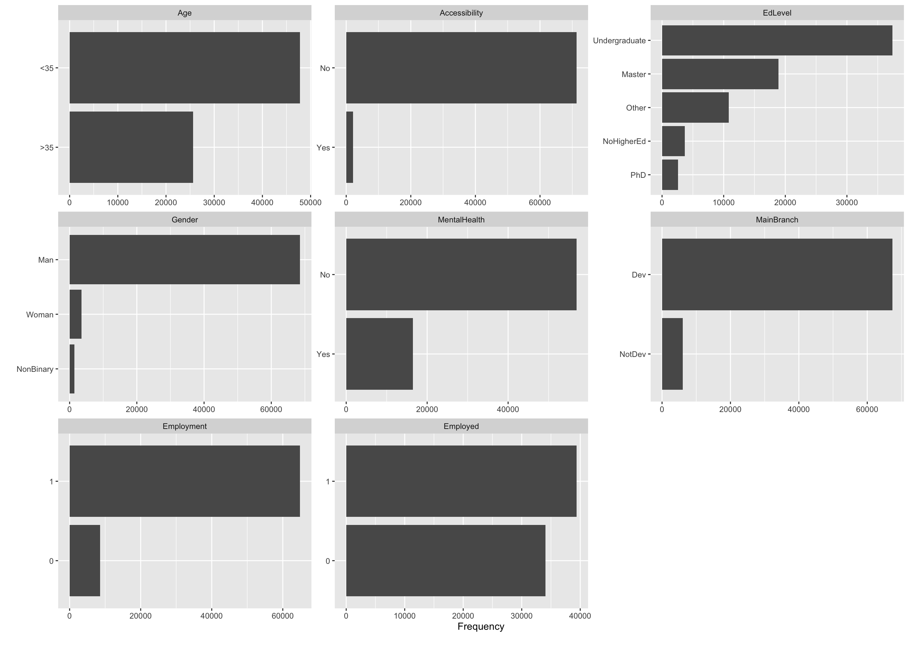
Bar Chart (with frequency)

Slide 10
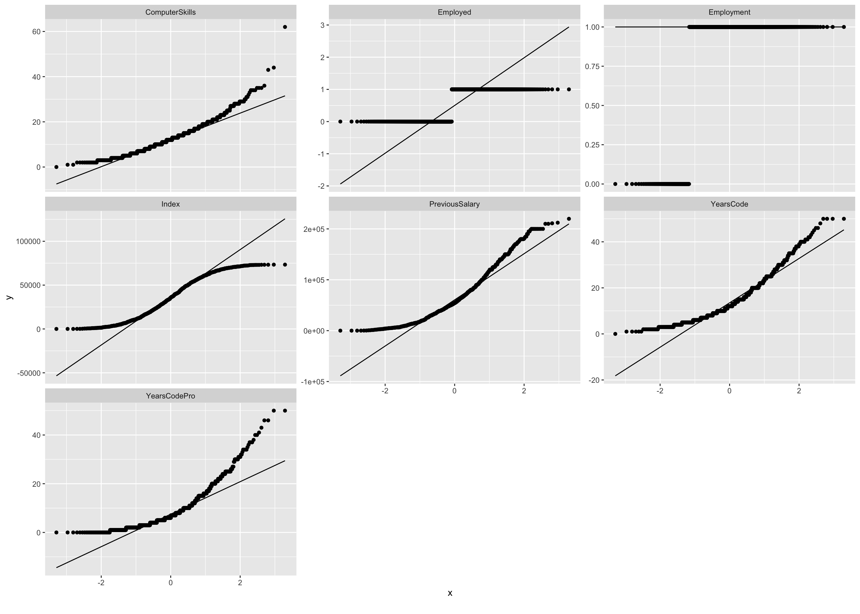
QQ Plot

Slide 11
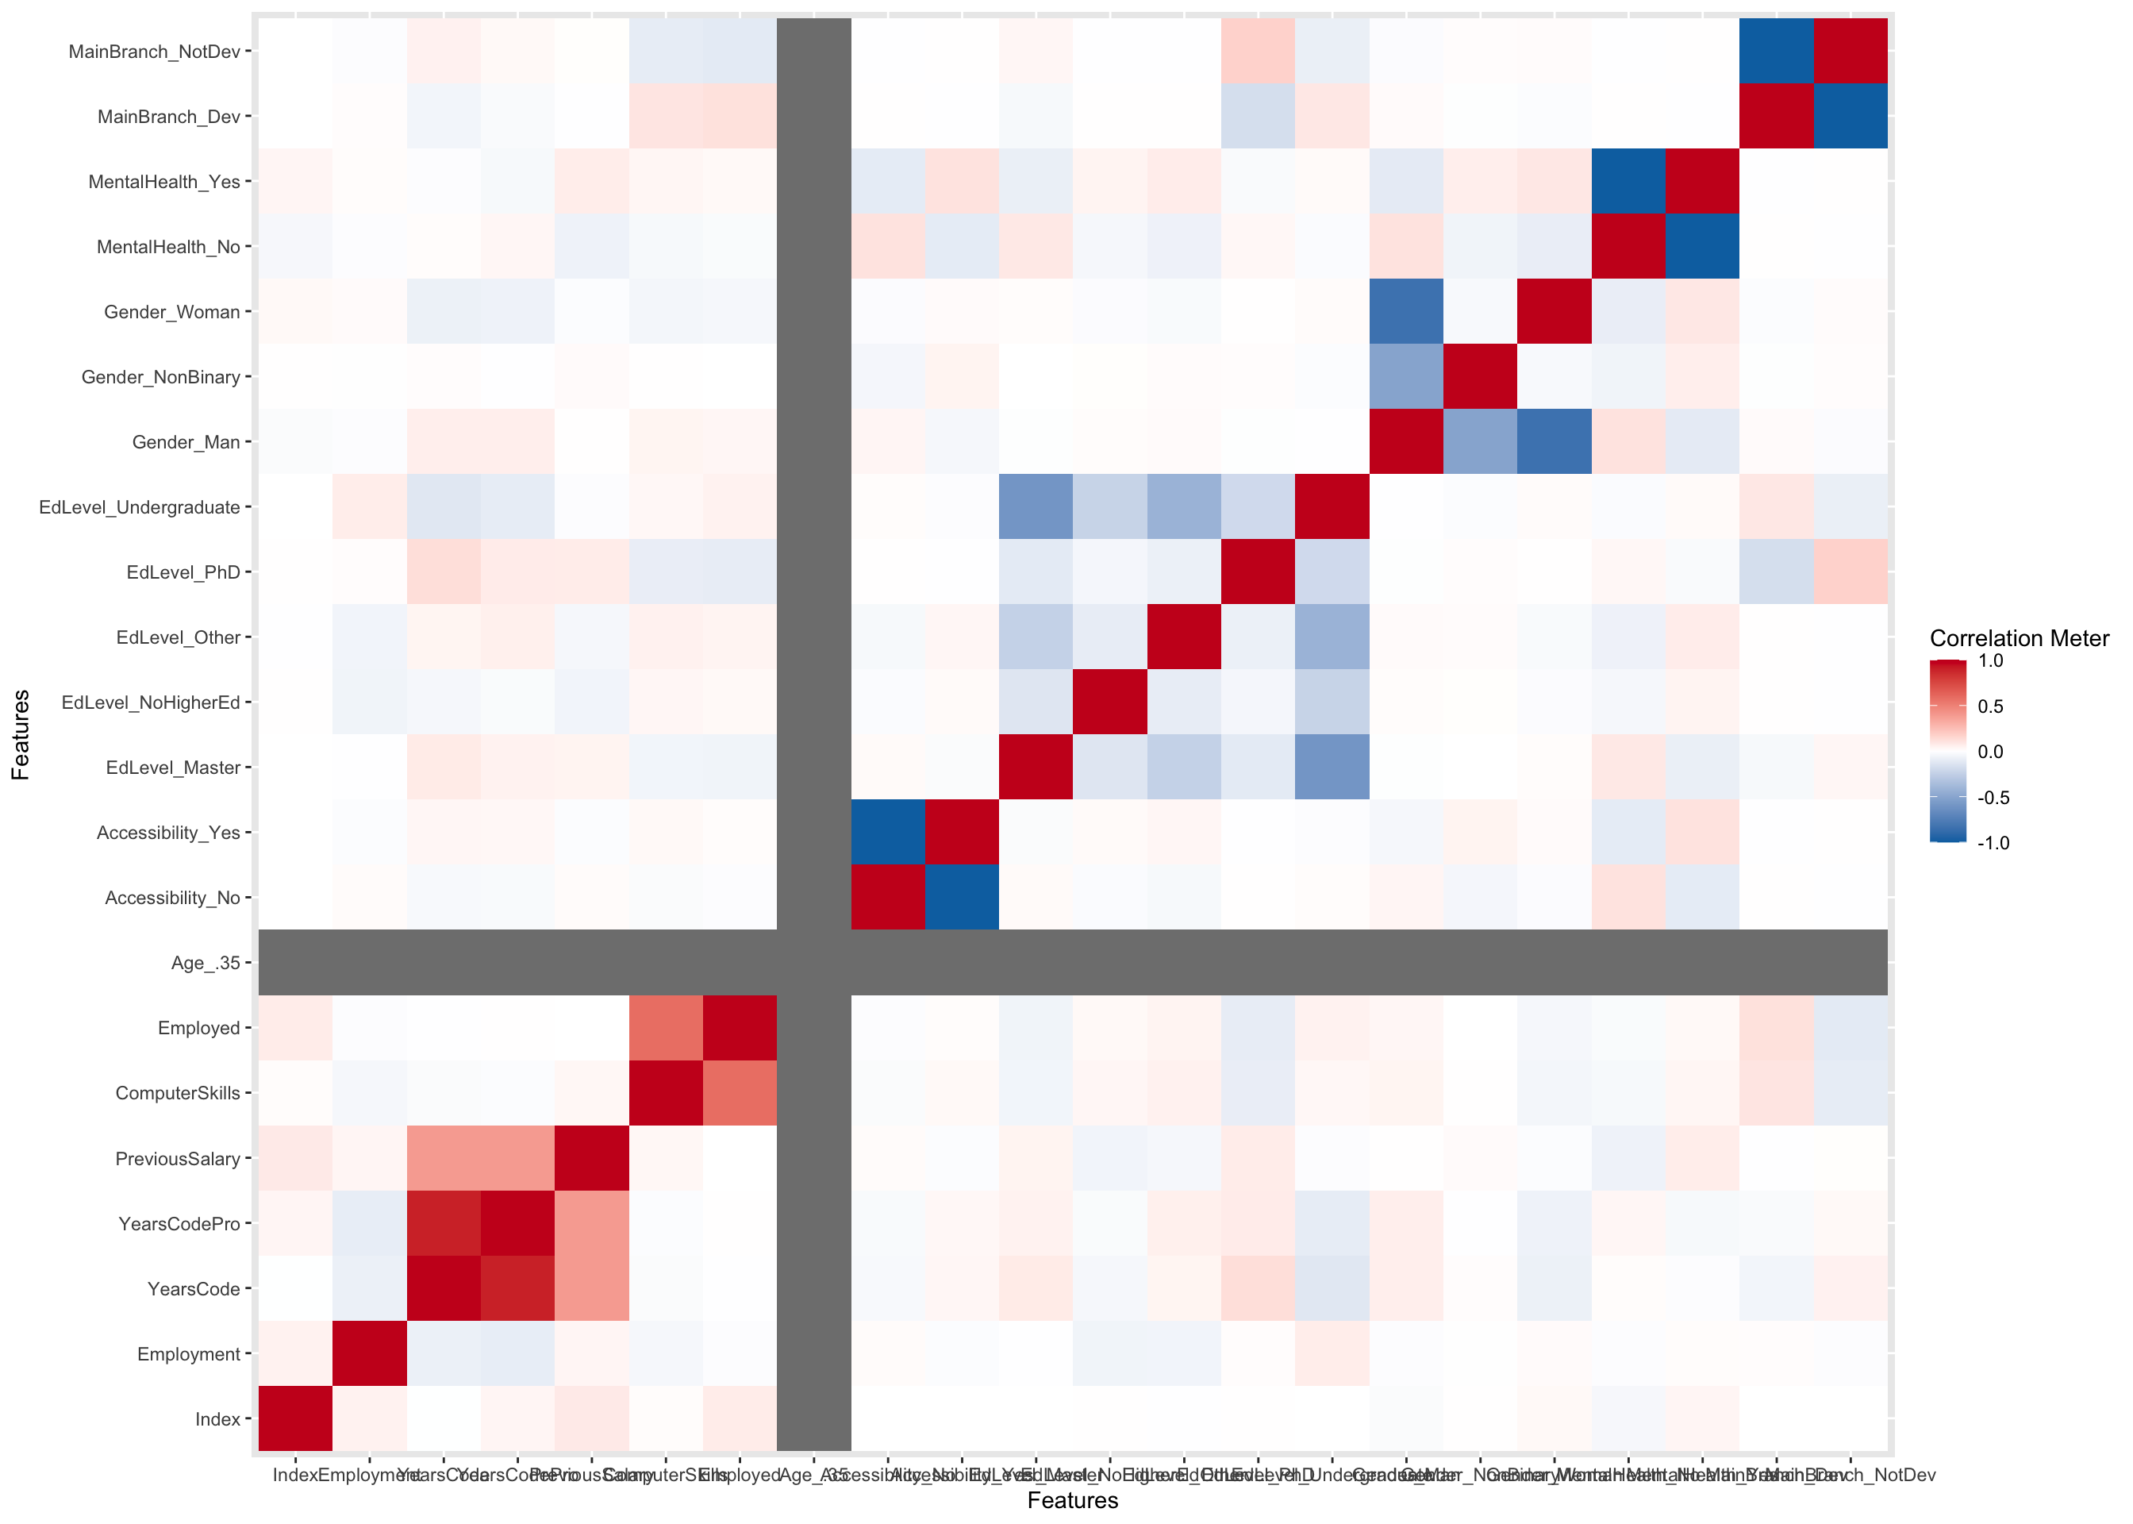
Correlation Analysis
Correlation analysis in this dataset can unveil relationships between applicant attributes and employability.
By quantifying associations, it helps identify key factors impacting hiring decisions, enabling organizations to make data-informed recruitment strategies.

Slide 12
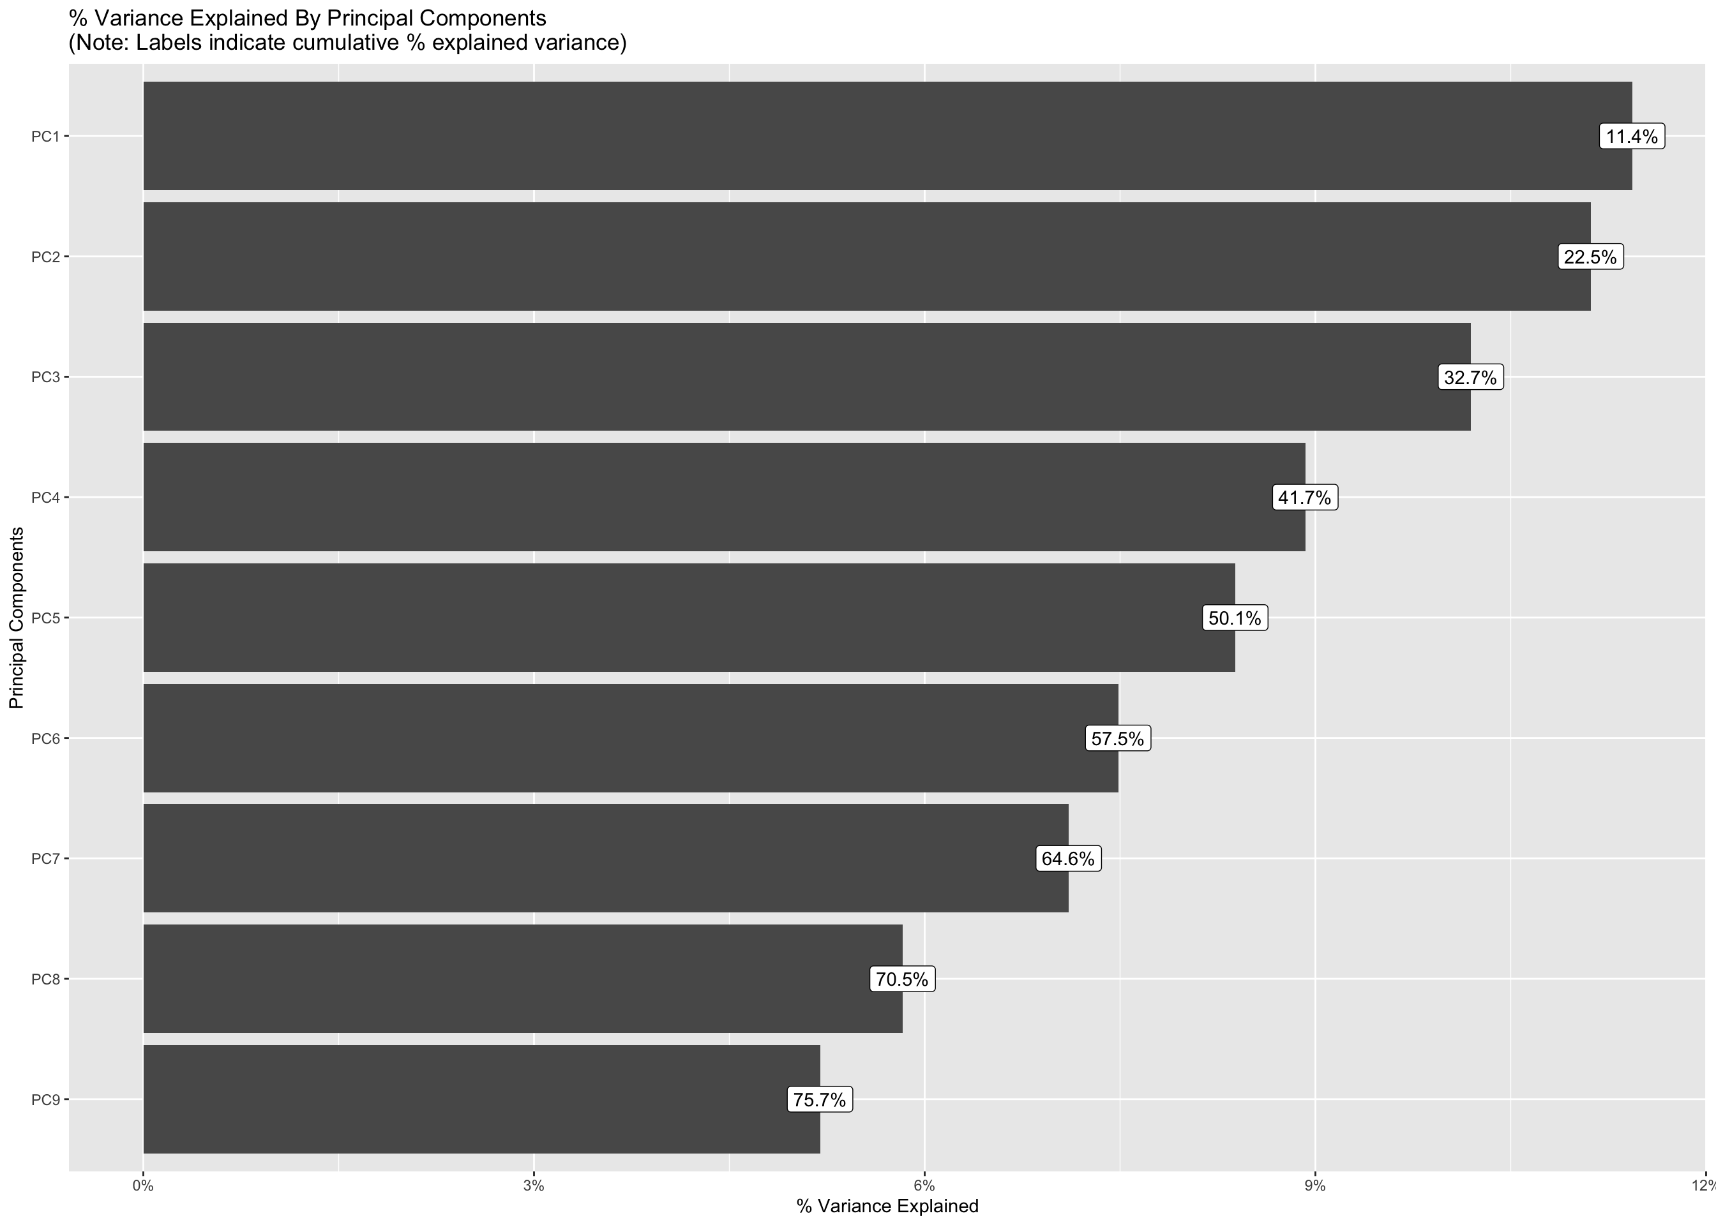
Principal Component Analysis
Principal Component Analysis (PCA) is a dimensionality reduction method that identifies key patterns in data by transforming variables into uncorrelated principal components.

Slide 13
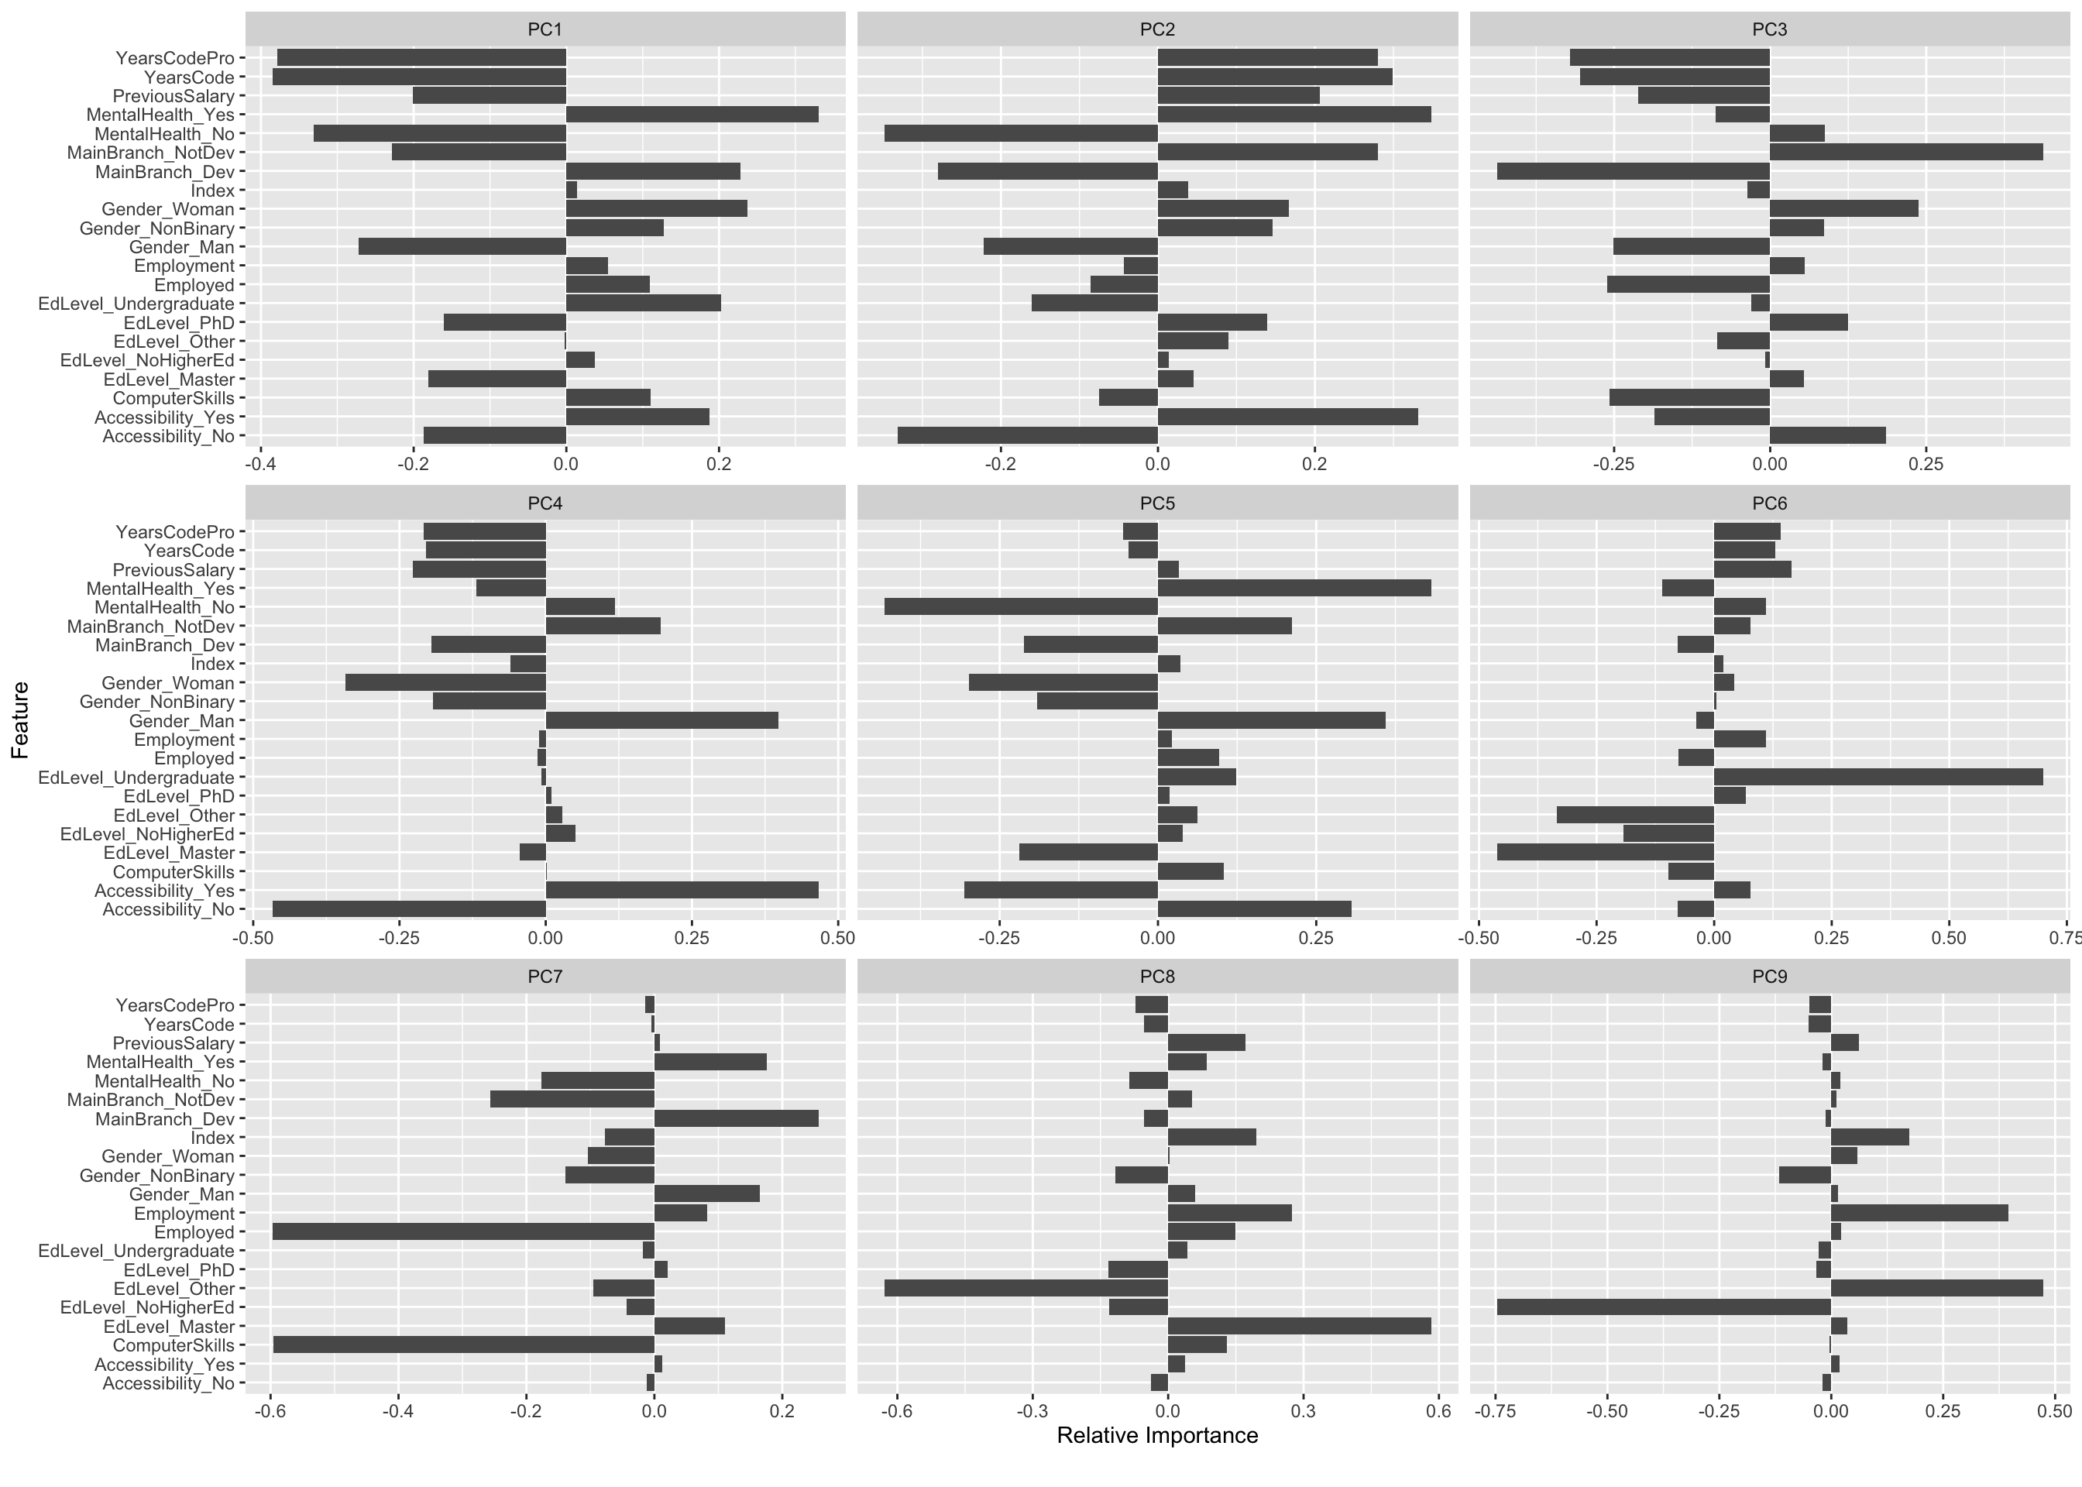

Slide 14
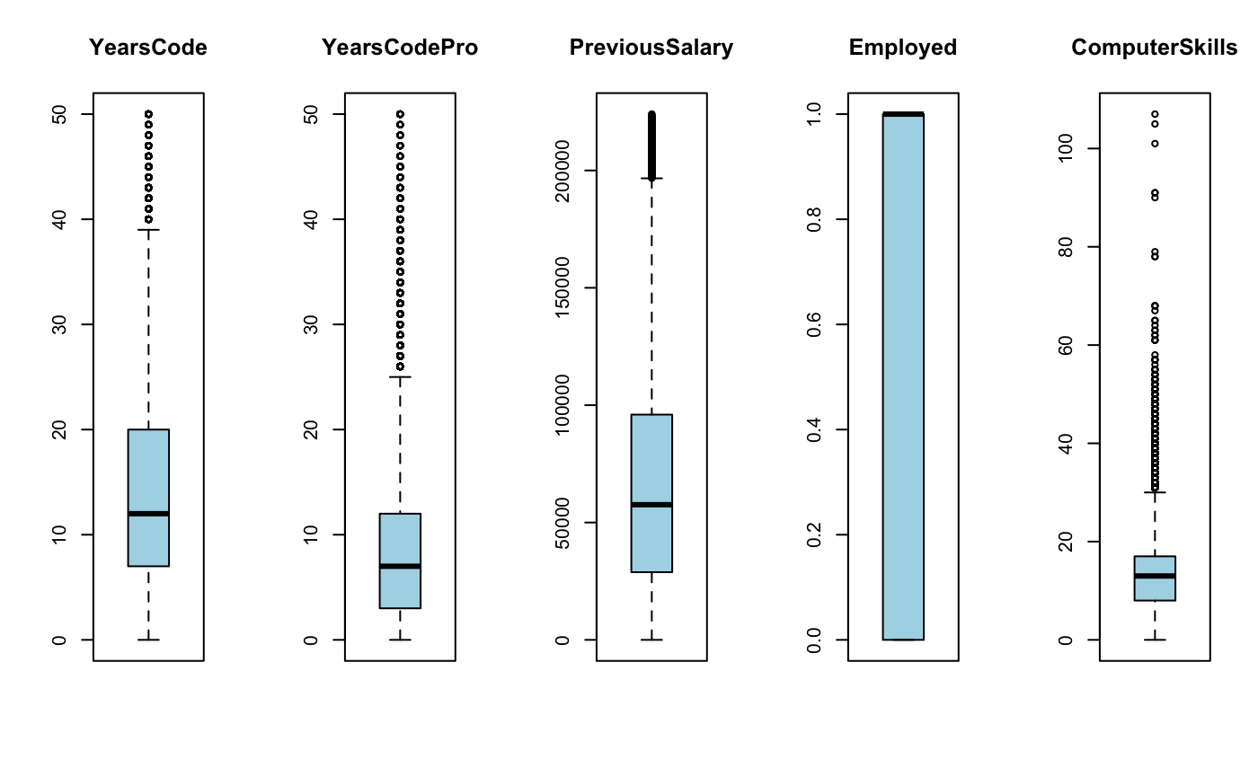

Slide 15
Outliers
Outlier removal was a crucial step in data preprocessing to enhance the dataset. Outliers, which are extreme or erroneous data points, could distort the employability classification model, leading to misleading results.
By eliminating outliers, we ensured that the model's predictions are based on the representative characteristics of job applicants, promoting fairness and reliability in the hiring process.
This approach also minimizes the risk of any undue influence of extreme cases, allowing for a more balanced and effective evaluation of candidate suitability.

Slide 16
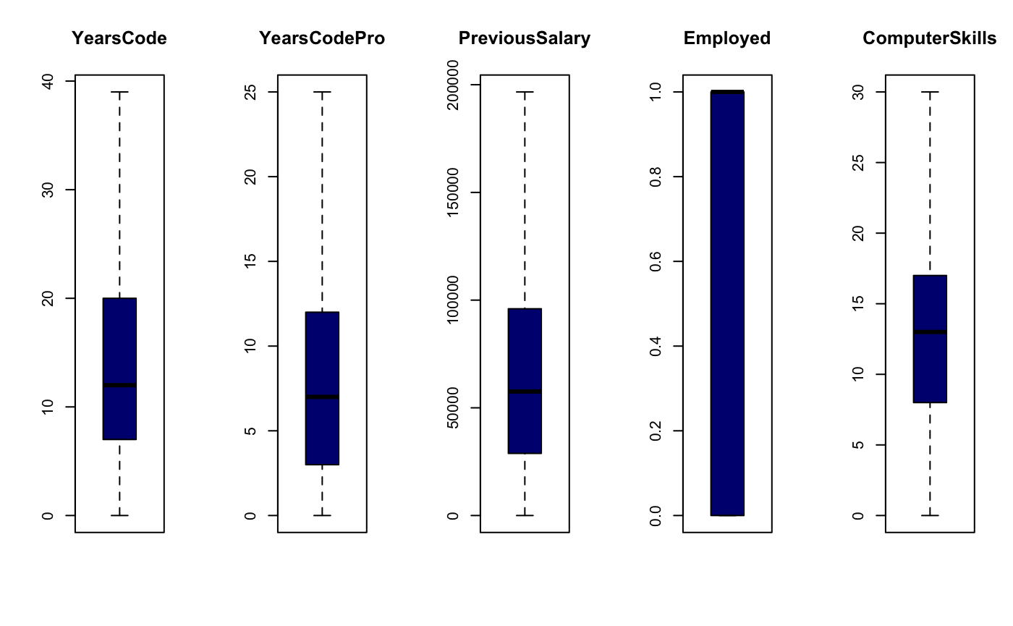

Slide 17
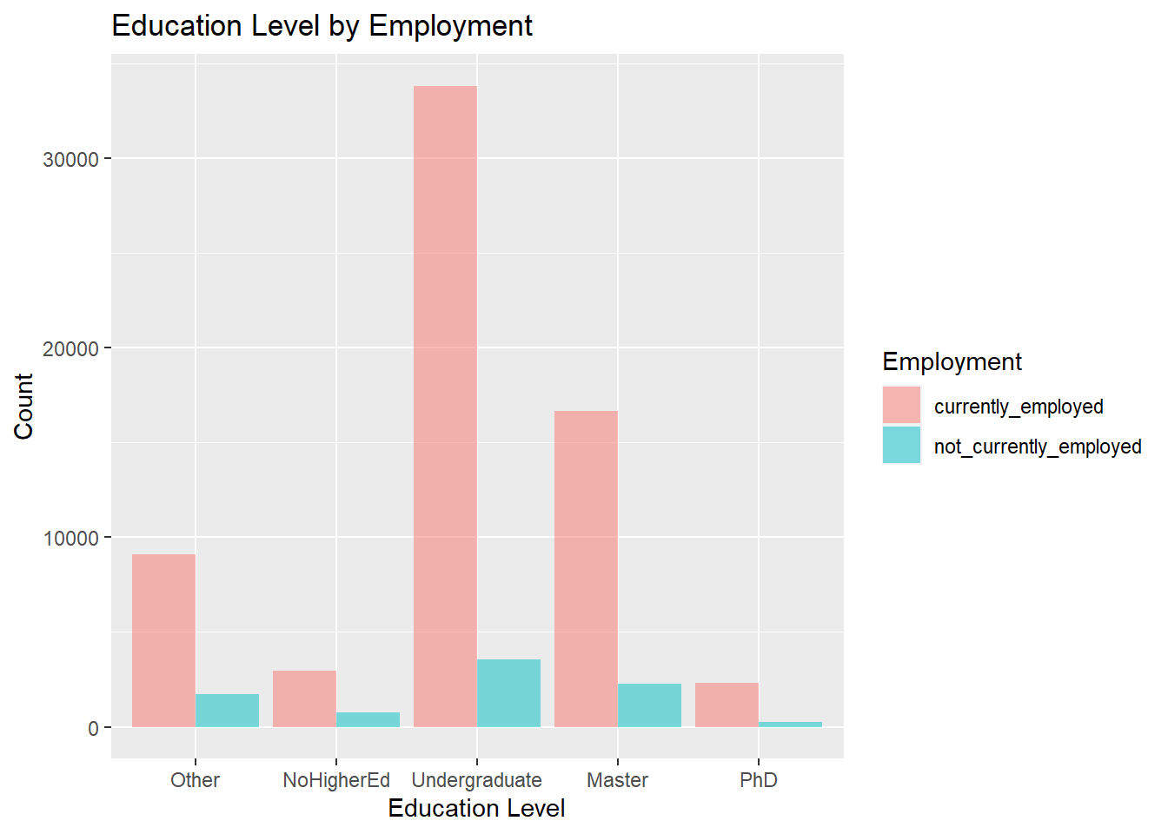
Exploratory Data Analysis
Hi, I’m Sajan. I’m a master’s student. ALAS! I see way more undergrads who’re employed

Slide 18
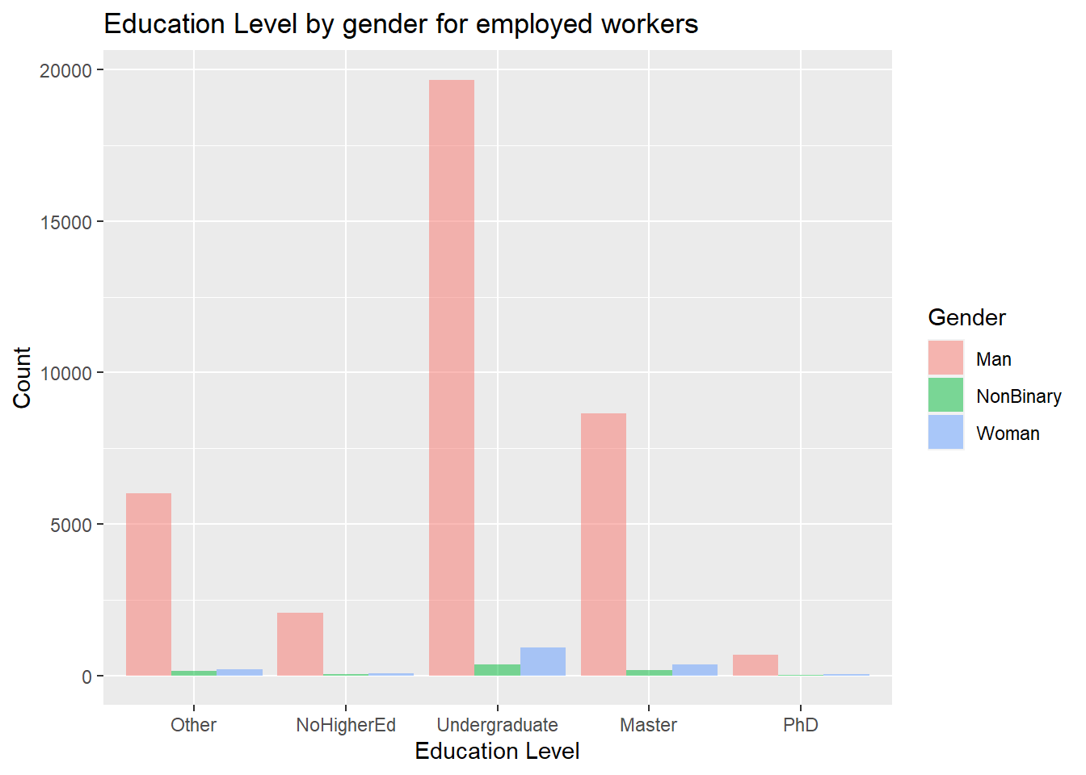
Exploratory Data Analysis
I identify as a man 🙂
I’m clearly in the majority 😌

Slide 19
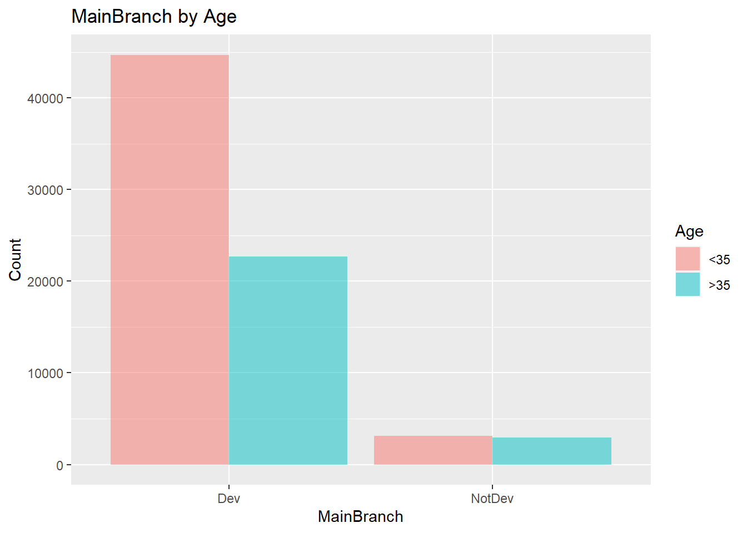
Exploratory Data Analysis
I’m from India.
there’s a lot of young population there.

Slide 20
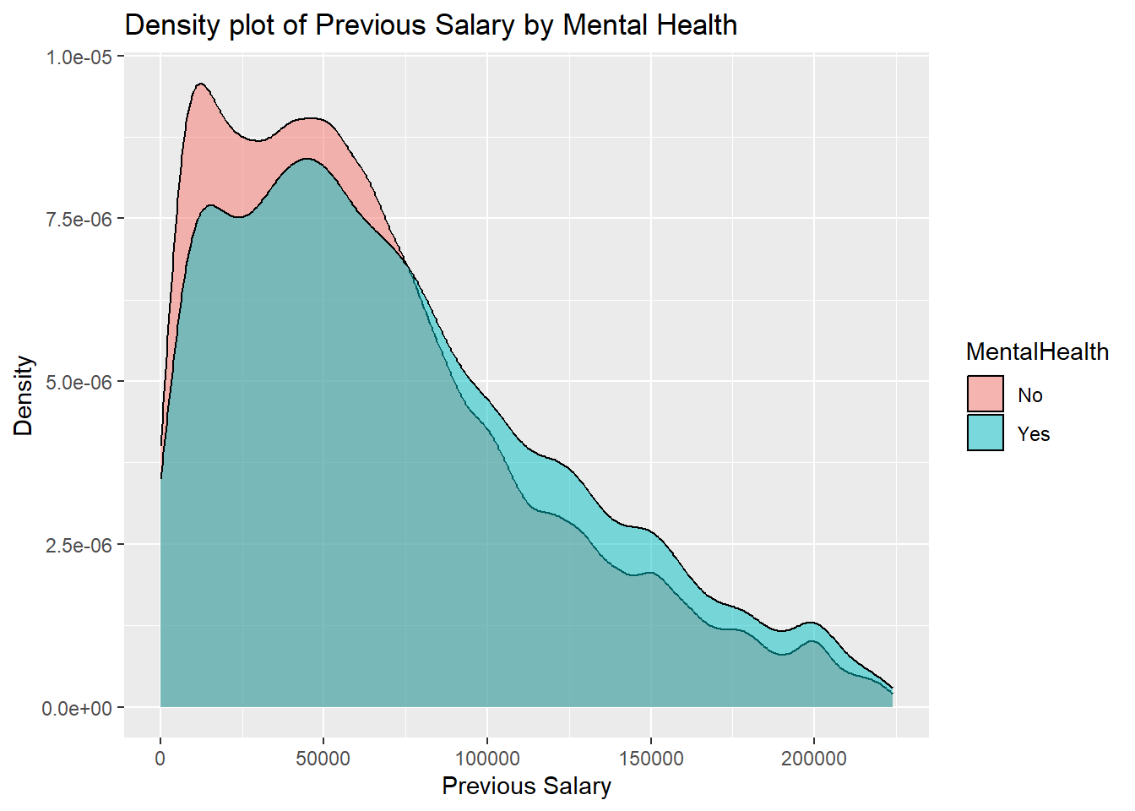
Exploratory Data Analysis
Guess my salary in the company I was working with….

Slide 21


Slide 22
Hypothesis Testing
Is there a significant difference between the proportion of males vs nonmales who are employed given their degree in higher education?
Two Proportions Z Test
Bachelor’s
Males Proportion: 31509/34855
Nonmales Proportion: 2319/2547
P-value: .299
Master’s
Males Proportion: 15477/17579
Nonmales Proportion: 1105/2547
P-value: < 2.2*10^-16
PhD
Males Proportion: 2153/2402
Nonmales Proportion: 185/206
P-value: ~1

Slide 23
Hypothesis Testing
Is there a difference in the average number of computer skills acquired based on level of education?
5 education levels + Continuous scaling for computer skills -> ANOVA test
aov(ComputerSkills ~ EdLevel, data=df_final)
F Test Statistic: 364.5, Degrees of Freedom: 4
P-value: < 2.2*10^-16
So we’d like to run a post hoc analysis to see where the differences occur…

Slide 24
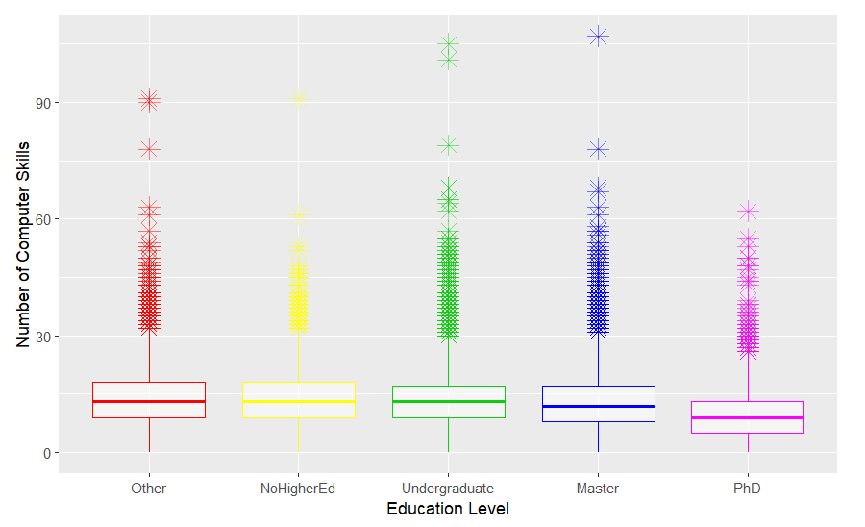
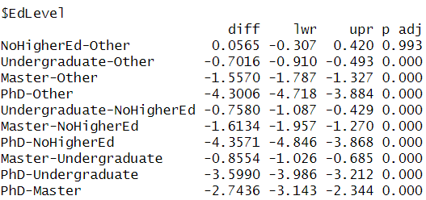
Hypothesis Testing
Is there a difference in the average number of computer skills acquired based on level of education? (continued)
Tukey’s test as a Post Hoc Analysis of our ANOVA test

Slide 25
Hypothesis Testing
Is age a significant factor in determining whether an individual is a professional developer or not?
Two Categorical Variables -> Contingency Table -> Chi Square Test of Independence
 | Professional Developer | Not a Professional Developer
Under 35 Years Old | 44710 | 3109
Over 35 Years Old | 22686 | 2957
Test Statistic: 556.78
Degrees of freedom (2-1)*(2-1) = 1
P-value: < 2.2*10^-16

Slide 26
Hypothesis Testing
Is status of mental health associated with a programmer’s previous salary?
Unknown Variance -> Two Sample t Test for Comparing Means
Individuals responded “Yes” or “No” when asked whether they face mental health issues
Test Statistic: 17.87
Degrees of Freedom: 25644
P-value: < 2.2*10^-16
Mean Salary for “Yes”: $73,992
Mean Salary for “No”: $65,940
**people who said "Yes" to mental health issues earn about $7,169 to $8,936 more than those who said "No”*
Notes:
The 95% confidence interval is 7169.656 to 8936.175

Slide 27

CONCLUSIONS
We will put conclusions here.

Slide 28
LIMITATIONS
Biases: There’s more info about males.
Human error: Mistakes in the data can affect the study's results.
Age: We don’t know in depth details of age(only under/above 35).
Categorization: Large number of categories complicate the analysis.
Data loss in cleaning: Fortunately, we got clean data to work with.
Notes:
Categorization- Say you have 50 categories in a feature. It’s way more complicated to visualize and comprehend it and than a feature having 3 categories

Slide 29

FURTHER RESEARCH
DEEPEN ANALYSIS: Dive deeper into specific categories, like age or country, for more detailed insights.
Predictive Modeling: Use the data to create models predicting employability, refining them as we gather more insights.

Slide 30

COMMENTS / QUESTIONS?
This Photo by Unknown Author is licensed under CC BY-SA

